Slide 1

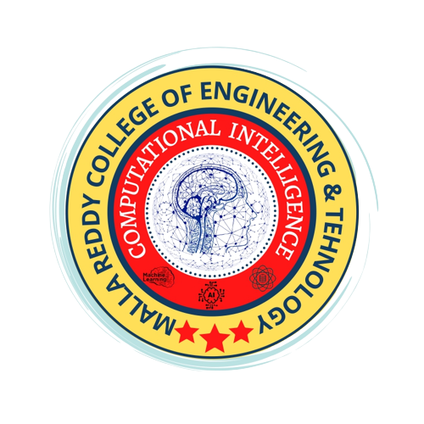
MALLA REDDY COLLEGE OF ENGINEERING & TECHNOLOGY (AUTONOMUS INSTITUTION –UGC, GOVT. OF INDIA) Affiliated to JNTUH; Approved by AICTE, NBA-Tier 1 & NAAC with A-GRADE| ISO 9001:2015
Deep Learning-Powered Railway Track Detection using Residual Network (ResNet)
Team Members
1. G.THAPASWINI REDDY – 22N31A7314
2. J. SAI VIGNESH – 22N31A7320
3. K.PURNA HARINI – 22N31A7326
IV Year B.Tech-II Semester – B. TECH (AIML)
Under the Guidance of
Dr. T. Siva Ratna Sai
Associate Professor
B.Tech IV Year – I Sem | Dept of Computational Intelligence| Mini Project | Project Review - 1

Slide 2

Agenda
MALLA REDDY COLLEGE OF ENGINEERING AND TECHNOLOGY
Abstract
Introduction
Existing System
Drawbacks of Existing System
Proposed System
Advantages of Proposed System
System Requirements
UML Diagrams
Conclusion
B.Tech IV Year – I Sem | Dept of Computational Intelligence| |

Slide 3
Abstract
MALLA REDDY COLLEGE OF ENGINEERING AND TECHNOLOGY
Railway track detection plays a critical role in ensuring the safety, reliability, and maintenance of railway transportation systems. Building upon the previous implementation using SegNet for pixel-wise segmentation, this project extends the approach by incorporating ResNet (Residual Neural Network) to improve classification accuracy and robustness. ResNet is a deep Convolutional Neural Network (CNN) that introduces residual learning through skip connections, enabling the model to train effectively even with increased depth. In this project, ResNet is used to classify images as “track” or “non-track,” focusing on improving detection accuracy and reducing misclassification in complex environments such as occlusions, varying lighting conditions, and background noise. By integrating ResNet into the detection pipeline, this project highlights how advanced deep learning architectures can significantly improve performance in real-world railway monitoring systems.
B.Tech IV Year – I Sem | Dept of Computational Intelligence| Project Phase - I | Project Review

Slide 4
Introduction
MALLA REDDY COLLEGE OF ENGINEERING AND TECHNOLOGY
Railway track detection is important for maintaining safety and preventing accidents in railway systems. Traditional methods are often slow and less accurate, especially in complex environments. To overcome these issues, this project uses ResNet, a deep learning model that improves detection performance.
ResNet uses advanced techniques like skip connections to learn features effectively, even in deep networks. In this project, it is used to identify whether an image contains a railway track or not. This approach improves accuracy, reduces errors, and makes the system more reliable for real-time railway monitoring.
B.Tech IV Year – I Sem | Dept of Computational Intelligence| Project Phase - I | Project Review

Slide 5
Existing System
MALLA REDDY COLLEGE OF ENGINEERING AND TECHNOLOGY
Existing System is incredibly slow and inefficient.
Earlier deep learning approaches like SegNet perform pixel-wise segmentation of tracks, but they require high computational power and struggle with accuracy in real-world scenarios.
These systems may produce incorrect segmentation results when the track is partially visible or when the environment is highly dynamic.
Performance may decrease with low-quality or limited data.
Although it improves detection compared to traditional methods, it still has some limitations.
B.Tech IV Year – I Sem | Dept of Computational Intelligence| Project Phase - I | Project Review

Slide 6
Drawbacks of Existing System
MALLA REDDY COLLEGE OF ENGINEERING AND TECHNOLOGY
It consumes a lot of time
High computational cost
Slower performance
Limited real-time capability
Moderate accuracy in complex conditions
B.Tech IV Year – I Sem | Dept of Computational Intelligence| Project Phase - I | Project Review

Slide 7
Proposed System
MALLA REDDY COLLEGE OF ENGINEERING AND TECHNOLOGY
The proposed system uses ResNet for railway track detection.
It is a deep learning model that classifies images as track or non-track.
ResNet uses residual (skip) connections, allowing deeper learning and better accuracy.
It overcomes the limitations of SegNet by improving speed and classification performance.
Works efficiently in complex environments like low light, shadows, and noise.
Provides fast and accurate predictions, enabling real-time monitoring.
B.Tech IV Year – I Sem | Dept of Computational Intelligence| Project Phase - I | Project Review

Slide 8
Advantages of Proposed System
MALLA REDDY COLLEGE OF ENGINEERING AND TECHNOLOGY
Fully Automated
High Accuracy
Real-Time Detection
Low Cost in Long Term
Improves Safety
B.Tech IV Year – I Sem | Dept of Computational Intelligence| Project Phase - I | Project Review

Slide 9
System Requirements
MALLA REDDY COLLEGE OF ENGINEERING AND TECHNOLOGY
B.Tech IV Year – I Sem | Dept of Computational Intelligence| Project Phase - I | Project Review

Slide 10
MALLA REDDY COLLEGE OF ENGINEERING AND TECHNOLOGY
Software Requirements
Programming Language : Python 3.12
Operating System : Windows 11
IDE : Jupyter Notebook
Libraries : OpenCV, TensorFlow
B.Tech IV Year – I Sem | Dept of Computational Intelligence| Project Phase - I | Project Review

Slide 11
Hardware Requirements
MALLA REDDY COLLEGE OF ENGINEERING AND TECHNOLOGY
Processor: Intel i5
RAM: 8 GB
Hard disk: 1 TB
B.Tech IV Year – I Sem | Dept of Computational Intelligence| Project Phase - I | Project Review

Slide 12
UML DIAGRAMS

Slide 13
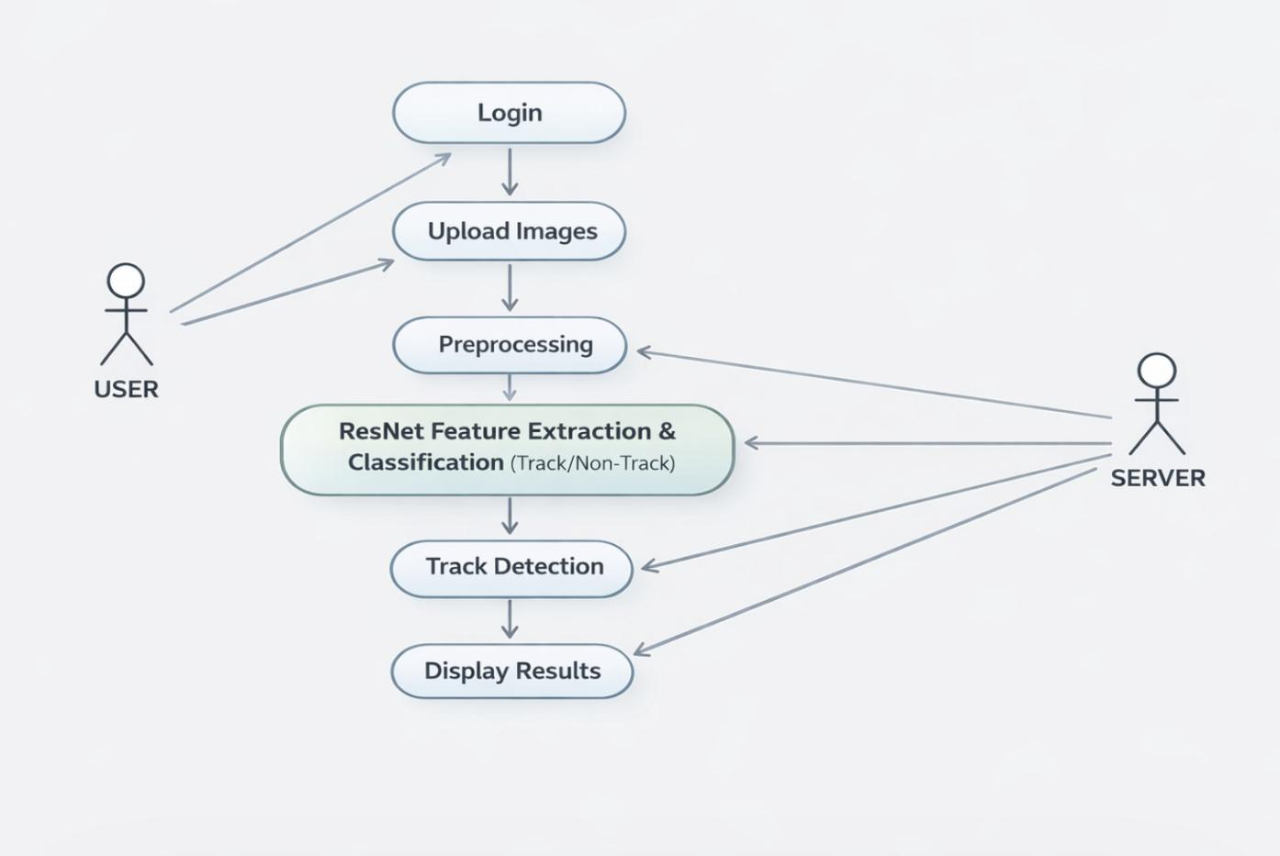
Use Case Diagram

Slide 14
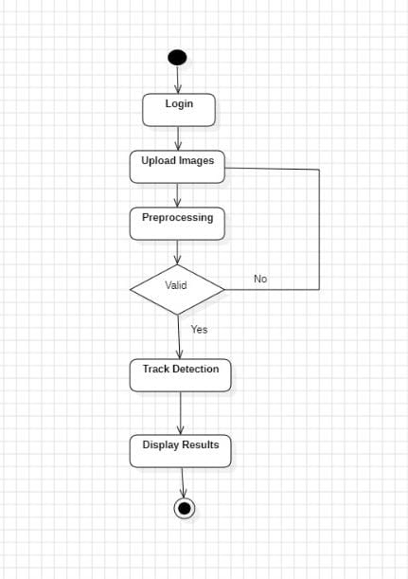
Activity Diagram

Slide 15
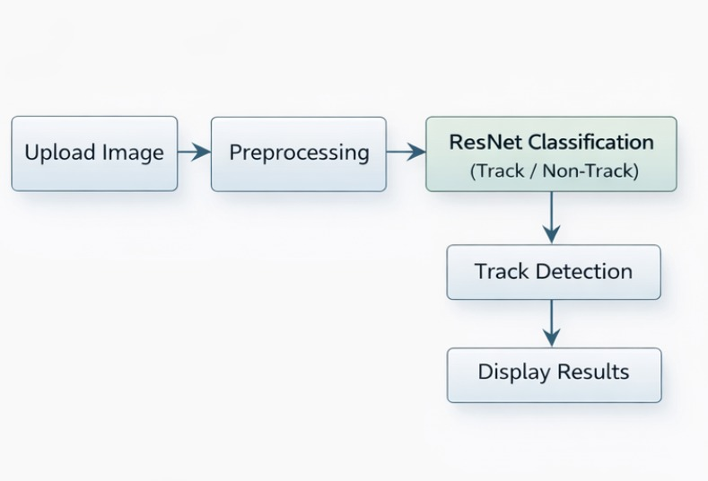
Data Flow Diagram

Slide 16
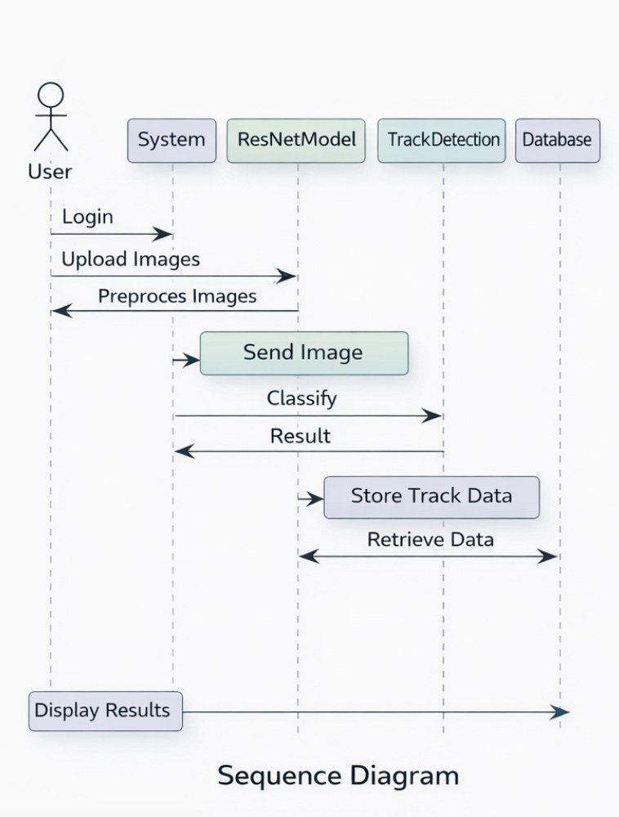
Sequence Diagram

Slide 17
Conclusion
The project successfully demonstrates how deep learning can be applied to detect railway tracks automatically from images.
The model performs well even in complex environments, making it suitable for real- world railway monitoring applications.
Overall, the project shows the potential of Al-powered solutions in improving the safety, ef tiency, and reliability of railway infrastructure maintenance.

Slide 18
MALLA REDDY COLLEGE OF ENGINEERING AND TECHNOLOGY
Thank You…
B.Tech IV Year – I Sem | Dept of Computational Intelligence| Project Phase - I | Project Review

